Slide 1
PREDICTION OF HEART Disease using MACHINE LEARNING

Slide 2
Group Members Information
Haripriya Eddala (700746136)
Sahithi Gunda (700745560)
Grandhe Sahitya Vidya Laxmi (700745900)
Varshitha Vadapally (700747161)

Slide 3
ROLES AND RESPONSIBILITIES:
Sahithi Gunda | Collected Data and worked on Linear SVC and Decision Tree.
Grandhe Sahitya Vidya Laxmi | Analysed Data and worked on Logistic Regression and Decision Tree.
Haripriya Eddala | Data visualization and worked on Random Forest and Gaussian Naïve Bayes.
Varshitha Vadapally | Imported modules, compared accuracies and worked on KNeighborsClassifier and Gaussian Naïve Bayes.

Slide 4
MOTIVATION :
Heart disease, also known as cardiovascular disease, refers to a range of conditions that affect the heart and blood vessels.
The proposed paper uses ML algorithms to predict Heart disease using age, cholesterol, chest pain type, exercise, induced angina, and max heart rate.
Heart disease prediction helps the patient from getting into the serious medical stage as it would be identified and cured at an initial stage.

Slide 5
OBJECTIVE :
Construct a different algorithms model that can be used for the prediction of heart disease using some real datasets.
Implement the k-NN, Random Forest, Linear SVC, Logistic Regression, Gaussian Naïve Bayes, and decision tree algorithms.
Compare the above algorithms by how accurately they can predict heart disease.
In comparison to those used in hospitals, the dataset we use ought to be minimal.

Slide 6
RELATIVE WORK :
Understanding the k-NN, Random Forest, Linear SVC, Logistic Regression, Gaussian Naive Bayes, and decision tree algorithms to solve real-world situations.
The use of hybrid algorithms and a combination of supervised with unsupervised and ML with DL methods are promising to provide better results.

Slide 7
PROBLEM STATEMENT :
Coronary artery disease is a common heart condition that affects the major blood vessels that supply the heart muscle. Cholesterol deposits (plaques) in the heart arteries are usually the cause of coronary artery disease. The buildup of these plaques is called atherosclerosis (ath-ur-o-skluh-ROE-sis). Atherosclerosis reduces blood flow to the heart and other parts of the body. It can lead to a heart attack, chest pain (angina) or stroke.
Heart Disease Prediction System is developed where the user can input the patient details and the prediction for the particular patient is made using the model developed. The model will predict the output to be either normal or risky using Gaussian Naive Bayes, Random Forest, K-Nearest Neighbour, linear Svc, Logistic regression, and Decision Tree Algorithms.

Slide 8
PROPOSED SOLUTIONS :
Calculating the accuracies for the below algorithms and checking which has the highest accuracy, which helps the patient to whether to consult a doctor or not.
Gaussian Naive Bayes
Random Forest
K-Nearest Neighbour
linear SVC
Logistic regression
Decision Tree

Slide 9
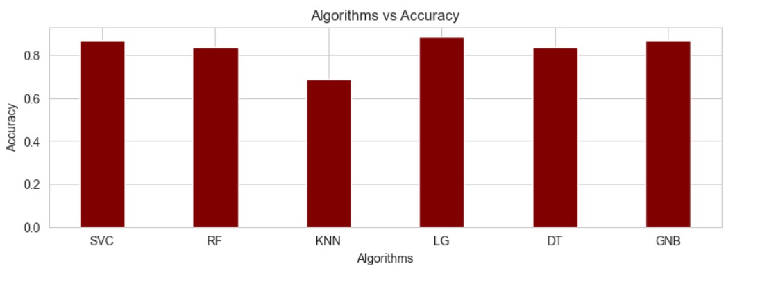
RESULTS :

Slide 10
REFERENCES :
A. Singh and R. Kumar, "Heart Disease Prediction Using Machine Learning Algorithms," 2020 International Conference on Electrical and Electronics Engineering (ICE3), Gorakhpur, India, 2020, pp. 452-457, doi: 10.1109/ICE348803.2020.9122958.
V. Sharma, S. Yadav and M. Gupta, "Heart Disease Prediction using Machine Learning Techniques," 2020 2nd International Conference on Advances in Computing, Communication Control and Networking (ICACCCN), Greater Noida, India, 2020, pp. 177-181, doi: 10.1109/ICACCCN51052.2020.9362842.
S. Farzana and D. Veeraiah, "Dynamic Heart Disease Prediction using Multi-Machine Learning Techniques," 2020 5th International Conference on Computing, Communication and Security (ICCCS), Patna, India, 2020, pp. 1-5, doi: 10.1109/ICCCS49678.2020.9277165.

Slide 11
THANK YOU

